Slide 1
Data Mining
Project Presentation
Team - Data Minors
Tirth Patel
Abhishek Bagepalli
Vishnu Anand

Slide 2
Introduction
Objective: Bankruptcy Prediction
Challenges:
Highly imbalanced classes - very few cases of bankruptcy.
Model complexity - Manual Hyperparameter Tuning
Data Partition vs Sampling
Slow TAT for SAS-EM Software
We took two approaches to solve this problem.

Slide 3
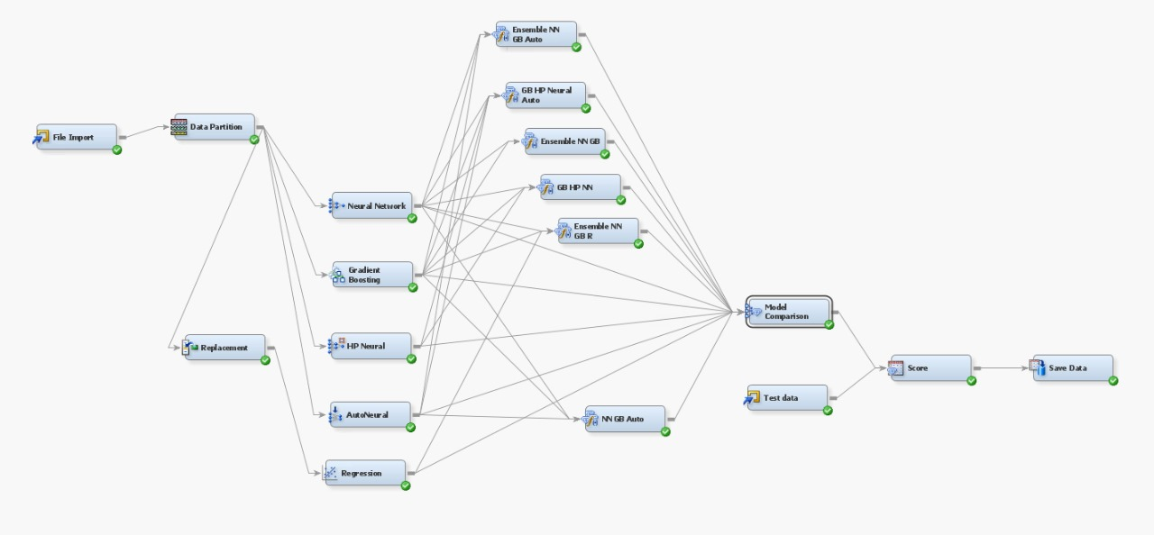
Approach 1

Slide 4
Workflow
• File Import: Load Dataset.
• Replacement: Handle outliers and ensure clean data.
• Data Partition: Split data into training, validation, and test subsets.
• Model Development: Train models like Regression, Neural Network, Gradient Boosting.
• Ensemble: Combine models (e.g., Neural Networks and Gradient Boosting) for better predictions.
• Evaluation: Compare models using metrics like AUC and Lift.

Slide 5
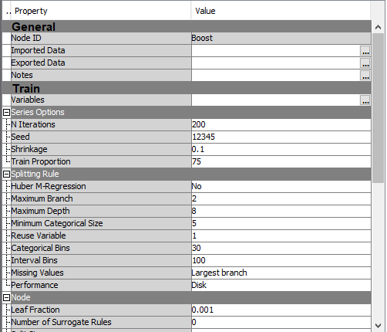
Settings
Sampling Method: Stratified Sampling
This method was used to oversample the minority class
Which was Bankruptcy.
Data Preprocessing
Handled extreme values considered to be outliers.
Maximum Tree Depth: 8
With 65 features, a depth of 8 allows the model to capture intricate patterns and interactions between variables without being too shallow to underfit.

Slide 6
Results
Best Performing Model
Performance Metrics
Training ROC: 99.6%
Validation ROC: 91.8%
Performance on Test (Private): 94.8%
Ensemble of Neural Network, Gradient Boosting Decision Trees and Polynomial Logistic Regression

Slide 7
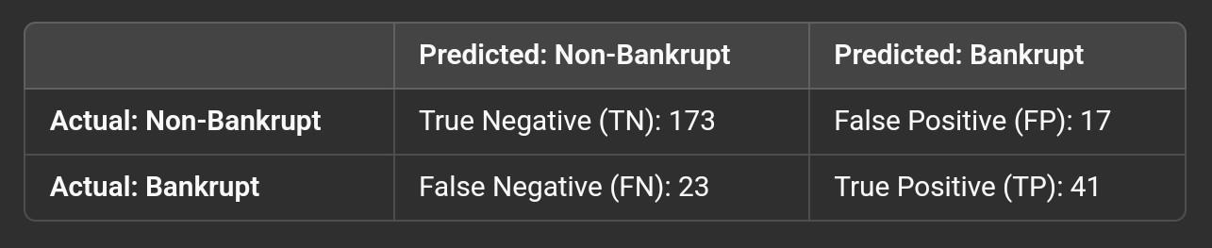
Confusion Matrix

Slide 8
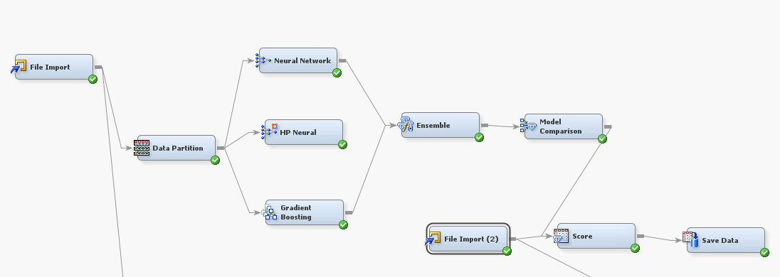
Approach 2 - Best Model

Slide 9
Workflow
• File Import: Load Dataset.
• Data Partition: Split data into training, validation, and test subsets.
• Model Development: Train models like Regression, Neural Network, Gradient Boosting.
• Ensemble: Combine models (e.g., Neural Networks and Gradient Boosting) for better predictions.
• Evaluation: Compare models using metrics like AUC and Lift.

Slide 10
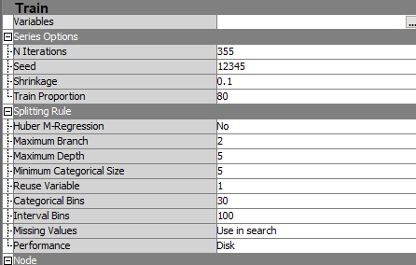
Settings
Number of Iterations: 355
This value was selected to ensure adequate training while avoiding overfitting or excessive computation time.
Maximum Tree Depth: 5
A depth of 5 was chosen to capture complex patterns in the data without making the model overly complex or prone to overfitting.
Learning Rate: 0.1
This learning rate provided the best balance between model accuracy and training stability during testing.

Slide 11
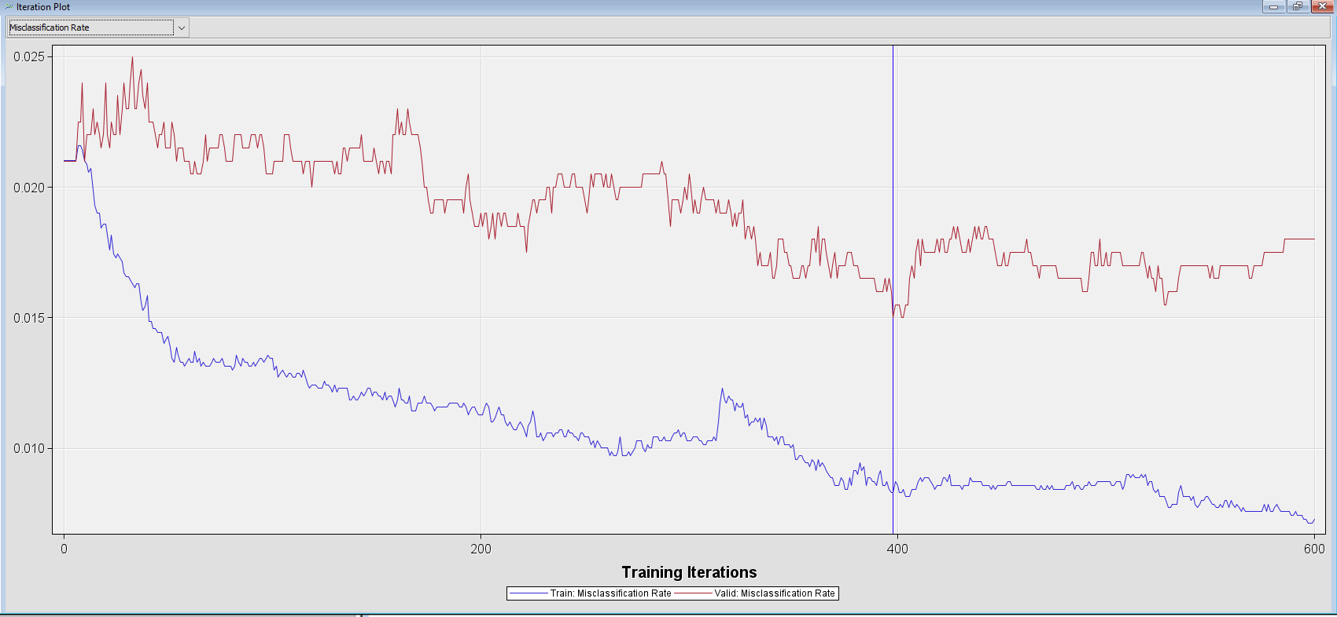
Misclassification Rate

Slide 12
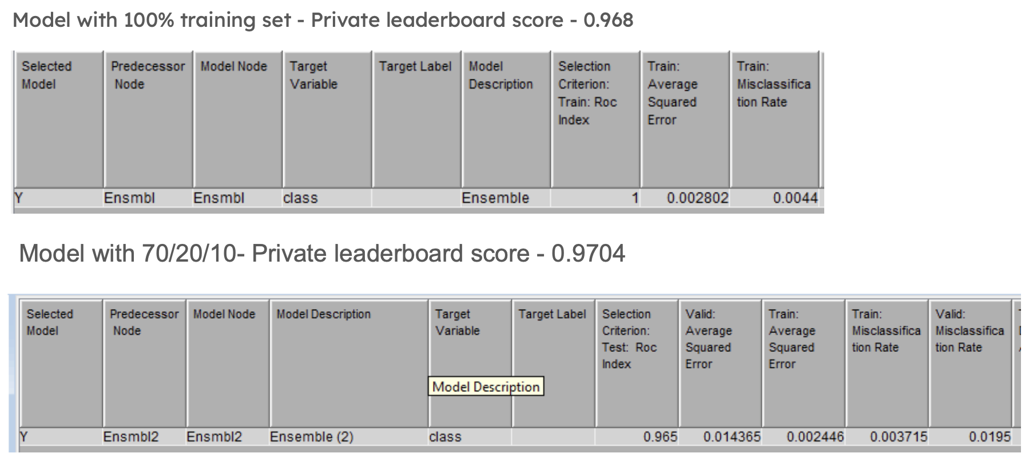
Final Result

Slide 13
Results
Best Performing Model
Performance Metrics
Training AUC: 100%
Training Misclassification - 0.44%
Performance on Test (Private): 96.8%
Ensemble of Neural Network
and
Gradient Boosting Decision Trees

